Slide 1

SEcube Utilities
A.A 2020/2021
Cybersecurity for Embedded Systems
A GUI for the SEcube device and its open source SDK
Students: Gaetano Galasso, Andrea Pignata, Andrea Russo

Slide 2
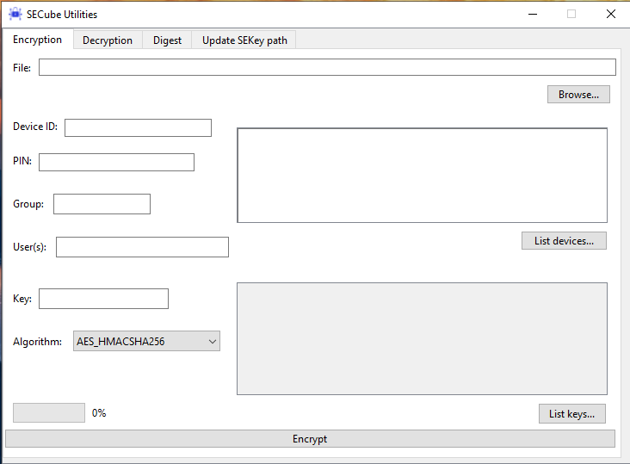
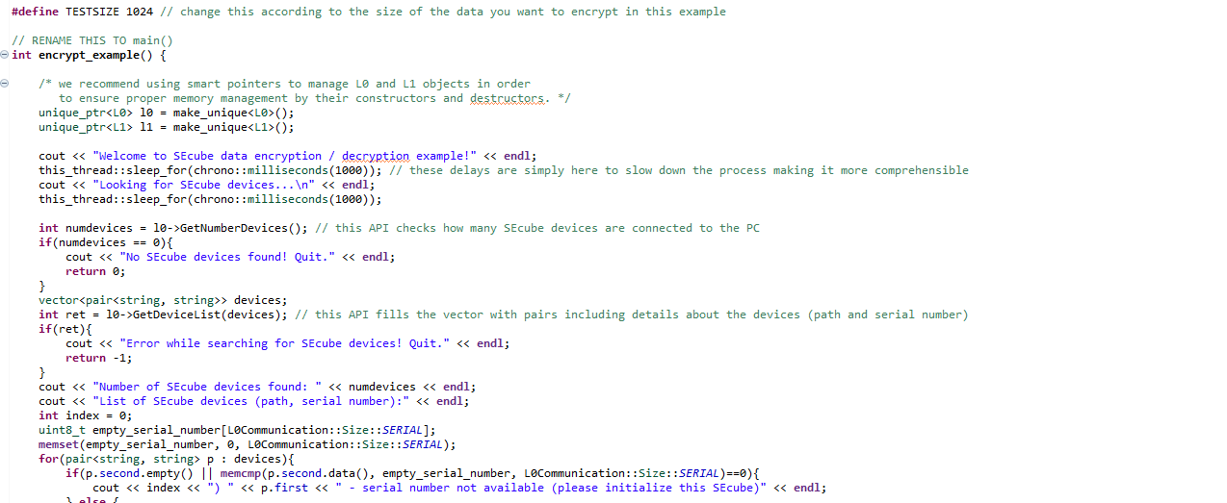

Why?
From this…
…to this
🤯
😌

Slide 3
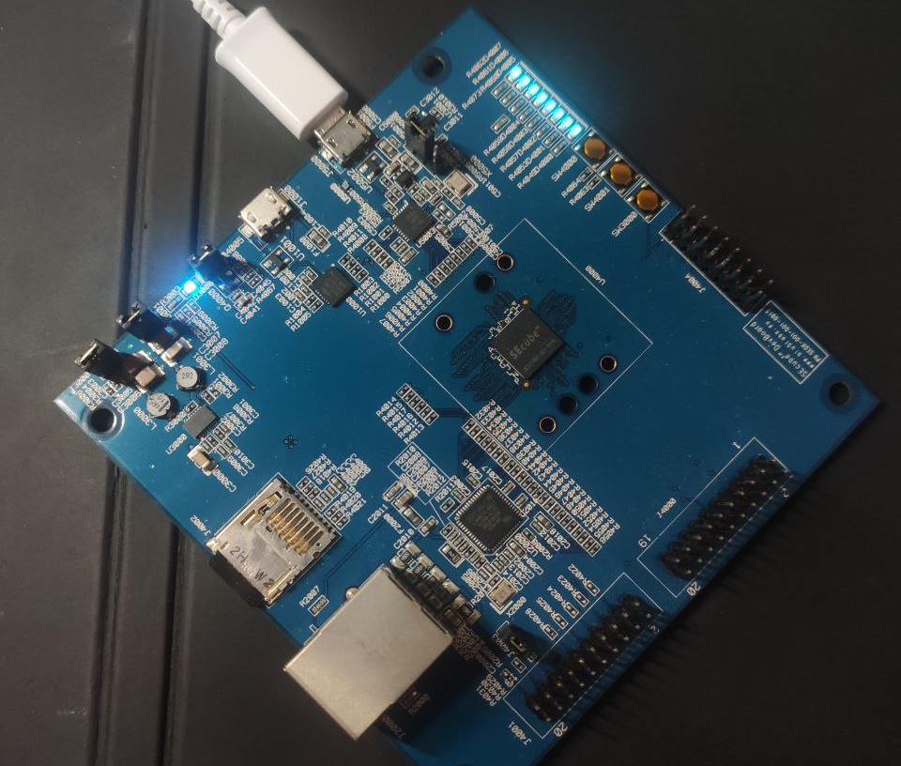
Goals
User-friendly interface
Targeted at the final user
Support for encryption and digest computation
Compatibility with manual key management, SEkey and SEfile
Compatibility with Linux and Windows

Slide 4
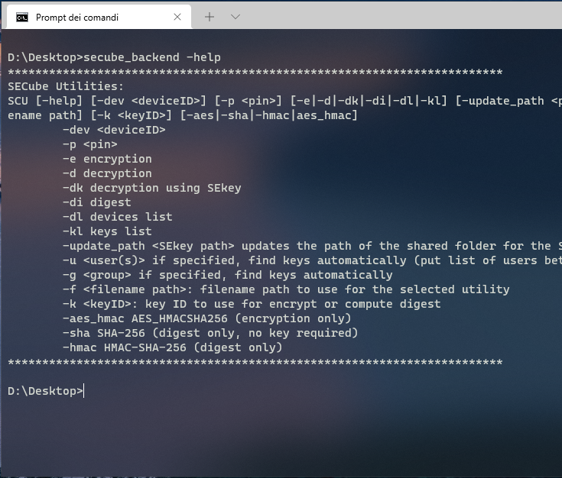
Backend
Fully featured command-line interface
Encryption, Decryption, Digest and some other general utilities
Entirely based on the SEcube open source SDK
Complete guide can be called with the –help argument
Supports socket communication with the GUI
Windows and Linux compatible

